Slide 1

Operating Systems Design​ Session 28: Demand Paging and Page Faults
19CS2106R​
© 2020 KL University

Slide 2
Demand Paging
Demand paging systems free processes from size limitations otherwise imposed by the amount of physical memory available on a machine
Processes tend to execute instructions in small portions of their text space, such as program loops and frequently called subroutines, and their data references tend to cluster in small subsets of the total data space of the process. This is known as the principle of "locality."
In operating systems, the concept of locality of reference states that, instead of loading the entire process in the main memory, OS can load only those number of pages in the main memory that are frequently accessed by the CPU and along with that, the OS can also load only those page table entries which are corresponding to those many pages.

Slide 3
Working Set
Working set of a process is the set of pages that the process has referenced in its last n memory references; the number n is called the window of the working set.
When a process addresses a page that is not in its working set, it incurs a page fault;
In handling the fault, the kernel updates the working set, reading in pages from a secondary device if necessary

Slide 4
Page Replacement
Operating System might have to replace one of the existing pages with the newly needed page.
Optimal Page replacement
First In First Out (FIFO)
Least Recently Used

Slide 5
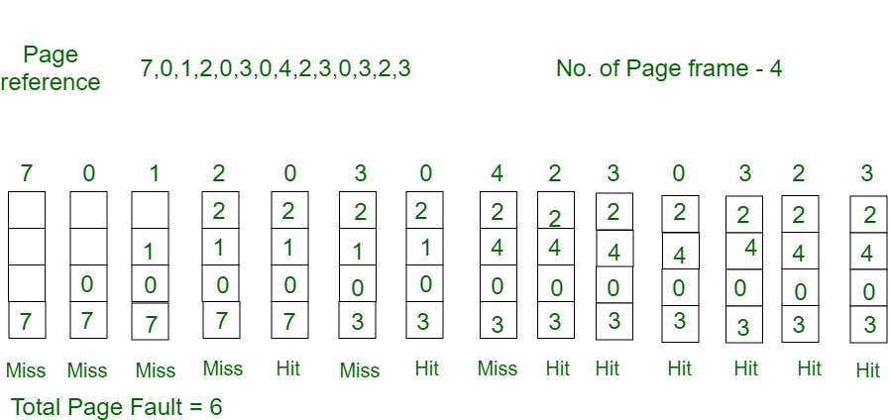
Optimal Page replacement
Optimal page replacement is perfect, but not possible in practice as the operating system cannot know future requests.

Slide 6
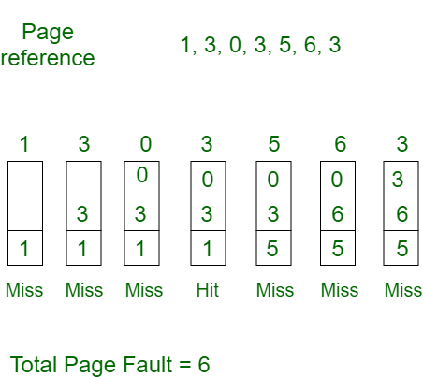
First In First Out (FIFO)
This is the simplest page replacement algorithm.
In this algorithm, the operating system keeps track of all pages in the memory in a queue, the oldest page is in the front of the queue.
When a page needs to be replaced page in the front of the queue is selected for removal.

Slide 7
First In First Out (FIFO) - Belady'sAnomaly
In FIFO page replacement algorithm, the number of page faults will get increased with the increment in number of frames.
The reference String is given as 0 1 5 3 0 1 4 0 1 5 3 4
Case 1: Number of frames = 3
Number of Page Faults = 9
Request | 0 | 1 | 5 | 3 | 0 | 1 | 4 | 0 | 1 | 5 | 3 | 4
Frame 3 |  |  | 5 | 5 | 5 | 1 | 1 | 1 | 1 | 1 | 3 | 3
Frame 2 |  | 1 | 1 | 1 | 0 | 0 | 0 | 0 | 0 | 5 | 5 | 5
Frame 1 | 0 | 0 | 0 | 3 | 3 | 3 | 4 | 4 | 4 | 4 | 4 | 4
Miss/Hit | Miss | Miss | Miss | Miss | Miss | Miss | Miss | Hit | Hit | Miss | Miss | Hit

Slide 8
First In First Out (FIFO) - Belady'sAnomaly
In FIFO page replacement algorithm, the number of page faults will get increased with the increment in number of frames.
The reference String is given as 0 1 5 3 0 1 4 0 1 5 3 4
Case 2: Number of frames = 4
Number of Page Faults = 10
Request | 0 | 1 | 5 | 3 | 0 | 1 | 4 | 0 | 1 | 5 | 3 | 4
Frame 4 |  |  |  | 3 | 3 | 3 | 3 | 3 | 3 | 5 | 5 | 5
Frame 3 |  |  | 5 | 5 | 5 | 5 | 5 | 5 | 1 | 1 | 1 | 1
Frame 2 |  | 1 | 1 | 1 | 1 | 1 | 1 | 0 | 0 | 0 | 0 | 4
Frame 1 | 0 | 0 | 0 | 0 | 0 | 0 | 4 | 4 | 4 | 4 | 3 | 3
Miss/Hit | Miss | Miss | Miss | Miss | Hit | Hit | Miss | Miss | Miss | Miss | Miss | Miss

Slide 9
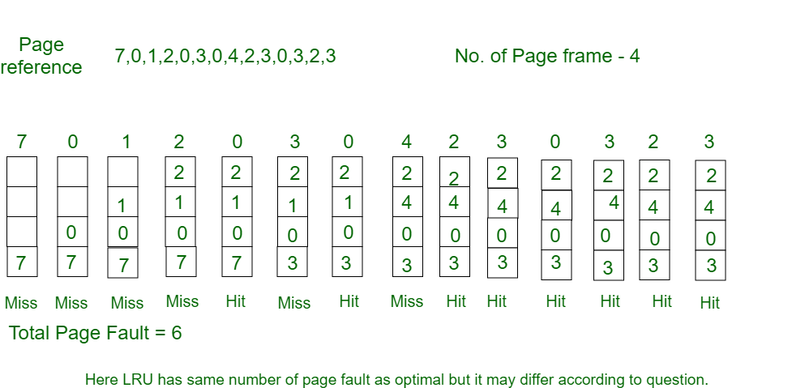
Least Recently Used

Slide 10
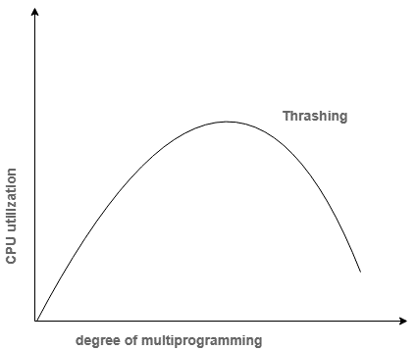
Thrashing
Thrashing is a condition or a situation when the system is spending a major portion of its time in servicing the page faults, but the actual processing done is very negligible.
If the page fault rate is PF %,
the time taken in getting a page from the secondary memory and again restarting is S (service time)
the memory access time is ma
then the effective access time can be given as;
EAT = PF X S + (1 - PF) X (ma)

Slide 11
Translation look aside buffer (TLB)
Drawbacks of Paging
Size of Page table
Effective access time
Translation look aside buffer
A Translation look aside buffer can be defined as a memory cache which can be used to reduce the time taken to access the page table again and again.
TLB follows the concept of locality of reference which means that it contains only the entries of those many pages that are frequently accessed by the CPU.

Slide 12
Translation look aside buffer (TLB)
Given a virtual address, the processor examines the TLB if a page table entry is present (TLB hit), the frame number is retrieved and the real address is formed.
TLB hit is a condition where the desired entry is found in translation look aside buffer. If this happens then the CPU simply access the actual location in the main memory.
However, if the entry is not found in TLB (TLB miss) then CPU has to access page table in the main memory and then access the actual frame in the main memory.
Therefore, in the case of TLB hit, the effective access time will be lesser as compare to the case of TLB miss.

Slide 13
Translation look aside buffer (TLB)
If the probability of TLB hit is P% (TLB hit rate) then the probability of TLB miss (TLB miss rate) will be (1-P) %.
Therefore, the effective access time can be defined as;
EAT = P (t + m) + (1 - p) (t + k.m + m)
Where, p → TLB hit rate, t → time taken to access TLB, m → time taken to access main memory k = 1, if the single level paging has been implemented.
By the formula, we come to know that
Effective access time will be decreased if the TLB hit rate is increased.
Effective access time will be increased in the case of multilevel paging.

Slide 14
Translation look aside buffer (TLB)
Consider a paging hardware with a TLB.
Assume that the entire page table and all the pages are in the physical memory.
It takes 10 milliseconds to search the TLB and 80 milliseconds to access the physical memory.
If the TLB hit ratio is 0.6, the effective memory access time (in milliseconds) is
EAT = P (t + m) + (1 - p) (t + k.m + m)
Effective Access Time (EAT) = 0.6 ( 10 + 80 ) + 0.4 ( 10 + 80 + 80 )
= 90 X 0.6 + 0.4 X 170
= 122

